Slide 2

Bird Shaman
Cape Dorset
Bird Shaman
Toonoo Sharky
gk }nr

Slide 3
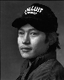
Bird Shaman
Toonoo Sharky, b. 1970
gk }nr
1995, Stone Cape Dorset, Cape Dorset Gift of Dr. Harry Winrob, 2006-516

Slide 4
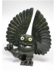

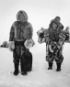
Bird Shaman
Exhibition
Toonoo Sharky, b. 1970
Community
gk }nr
REMOVED
1995, Stone Cape Dorset, Cape Dorset Gift of Dr. Harry Winrob, 2006-516

Slide 5
Bird Shaman
Exhibition
Toonoo Sharky, b. 1970
gk }nr
1995, Stone Cape Dorset, Cape Dorset Gift of Dr. Harry Winrob, 2006-516

Slide 6


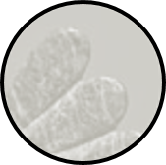
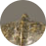
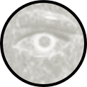
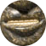
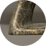
Bird Shaman
Toonoo Sharky, b. 1970
gk }nr
1995, Stone Cape Dorset, Cape Dorset Gift of Dr. Harry Winrob, 2006-516

Slide 7
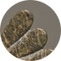
Bird Shaman
Toonoo Sharky, b. 1970
gk }nr
Shamanism among Eskimo peoples refers to those aspects of the Eskimo cultures that are related to the shamans’ role as a mediator between people and spirits, souls, and mythological beings. Such beliefs and practices were once widespread among Eskimo groups, but today are rarely practised.
1995, Stone Cape Dorset, Cape Dorset Gift of Dr. Harry Winrob, 2006-516

Slide 8
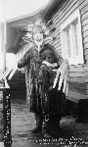
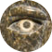
Bird Shaman
Toonoo Sharky, b. 1970
gk }nr
Shamanism among Eskimo peoples refers to those aspects of the Eskimo cultures that are related to the shamans’ role as a mediator between people and spirits, souls, and mythological beings. Such beliefs and practices were once widespread among Eskimo groups, but today are rarely practised.
1995, Stone Cape Dorset, Cape Dorset Gift of Dr. Harry Winrob, 2006-516

Slide 9
Bird Shaman
Toonoo Sharky, b. 1970
gk }nr
Shamanism among Eskimo peoples refers to those aspects of the Eskimo cultures that are related to the shamans’ role as a mediator between people and spirits, souls, and mythological beings. Such beliefs and practices were once widespread among Eskimo groups, but today are rarely practised.
Shamanism among Eskimo peoples refers to those aspects of the Eskimo cultures that are related to the shamans’ role as a mediator between people and spirits, souls, and mythological beings. Such beliefs and practices were once widespread among Eskimo groups, but today are rarely practised.
1995, Stone Cape Dorset, Cape Dorset Gift of Dr. Harry Winrob, 2006-516

Slide 10


Bird Shaman
Toonoo Sharky, b. 1970
gk }nr
Shamanism among Eskimo peoples refers to those aspects of the Eskimo cultures that are related to the shamans’ role as a mediator between people and spirits, souls, and mythological beings. Such beliefs and practices were once widespread among Eskimo groups, but today are rarely practiced.
Shamanism among Eskimo peoples refers to those aspects of the Eskimo cultures that are related to the shamans’ role as a mediator between people and spirits, souls, and mythological beings. Such beliefs and practices were once widespread among Eskimo groups, but today are rarely practiced.
1995, Stone Cape Dorset, Cape Dorset Gift of Dr. Harry Winrob, 2006-516

Slide 11
Bird Shaman
Toonoo Sharky, b. 1970
gk }nr
1995, Stone Cape Dorset, Cape Dorset Gift of Dr. Harry Winrob, 2006-516

Slide 12
Bird Shaman
Exhibition
Toonoo Sharky, b. 1970
gk }nr
1995, Stone Cape Dorset, Cape Dorset Gift of Dr. Harry Winrob, 2006-516

Slide 13
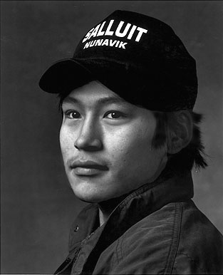

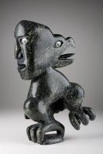
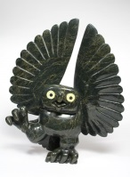
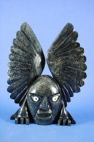
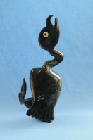
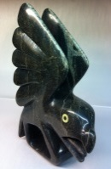
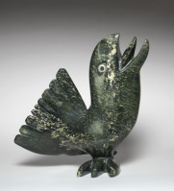
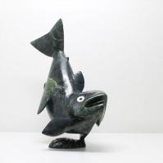
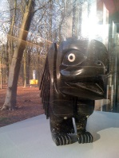
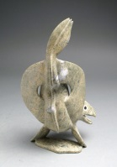
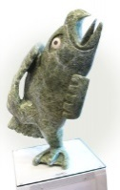
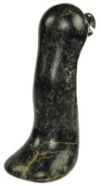
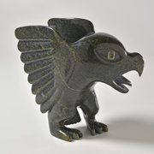
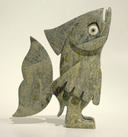
Toonoo Sharky, 1970
Cape Dorset, CA
Bird Shaman
Toonoo Sharky began carving at age nine, taught by his grandfather. His favourite subjects are “birds, and anything with wings.” But asked if he observed birds in nature, he replies: “Not often. You can look at them or work from your imagination. I don’t observe them; it is all from my head.” Toonoo’s visual statement is more emblematic than truly representative of the transformation process. For younger generations of Inuit, the imagining of shamanism and its various attributes has to a large extent supplanted actual knowledge of and belief in it.
Toonoo Sharky, b. 1970
gk }nr
1995, Stone Cape Dorset, Cape Dorset Gift of Dr. Harry Winrob, 2006-516

Slide 14
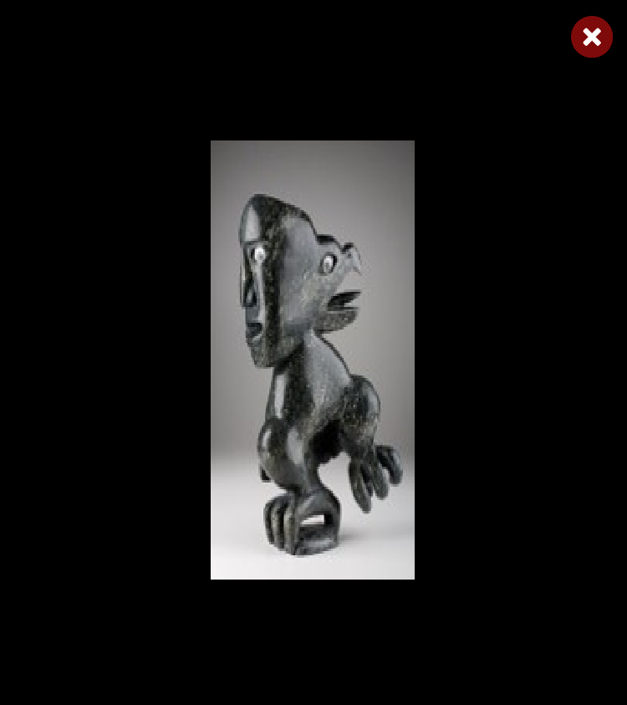
Toonoo Sharky, 1970
Cape Dorset, CA
Bird Shaman
Toonoo Sharky began carving at age nine, taught by his grandfather. His favourite subjects are “birds, and anything with wings.” But asked if he observed birds in nature, he replies: “Not often. You can look at them or work from your imagination. I don’t observe them; it is all from my head.” Toonoo’s visual statement is more emblematic than truly representative of the transformation process. For younger generations of Inuit, the imagining of shamanism and its various attributes has to a large extent supplanted actual knowledge of and belief in it.
Toonoo Sharky, b. 1970
gk }nr
1995, Stone Cape Dorset, Cape Dorset Gift of Dr. Harry Winrob, 2006-516

Slide 15
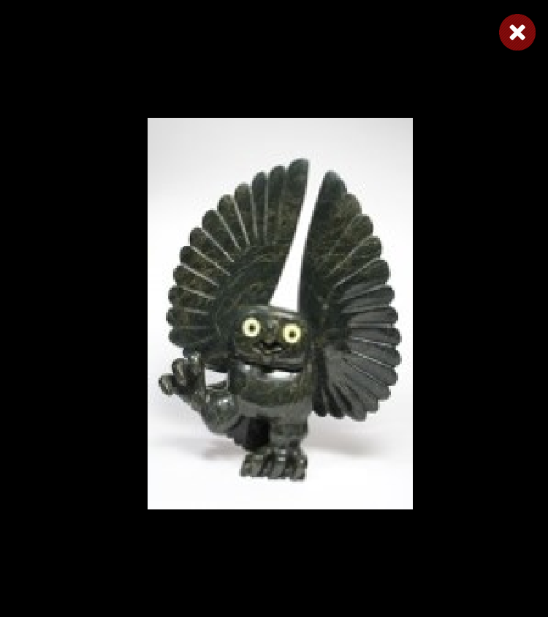
Toonoo Sharky, 1970
Cape Dorset, CA
Bird Shaman
Toonoo Sharky began carving at age nine, taught by his grandfather. His favourite subjects are “birds, and anything with wings.” But asked if he observed birds in nature, he replies: “Not often. You can look at them or work from your imagination. I don’t observe them; it is all from my head.” Toonoo’s visual statement is more emblematic than truly representative of the transformation process. For younger generations of Inuit, the imagining of shamanism and its various attributes has to a large extent supplanted actual knowledge of and belief in it.
Toonoo Sharky, b. 1970
gk }nr
1995, Stone Cape Dorset, Cape Dorset Gift of Dr. Harry Winrob, 2006-516

Slide 16
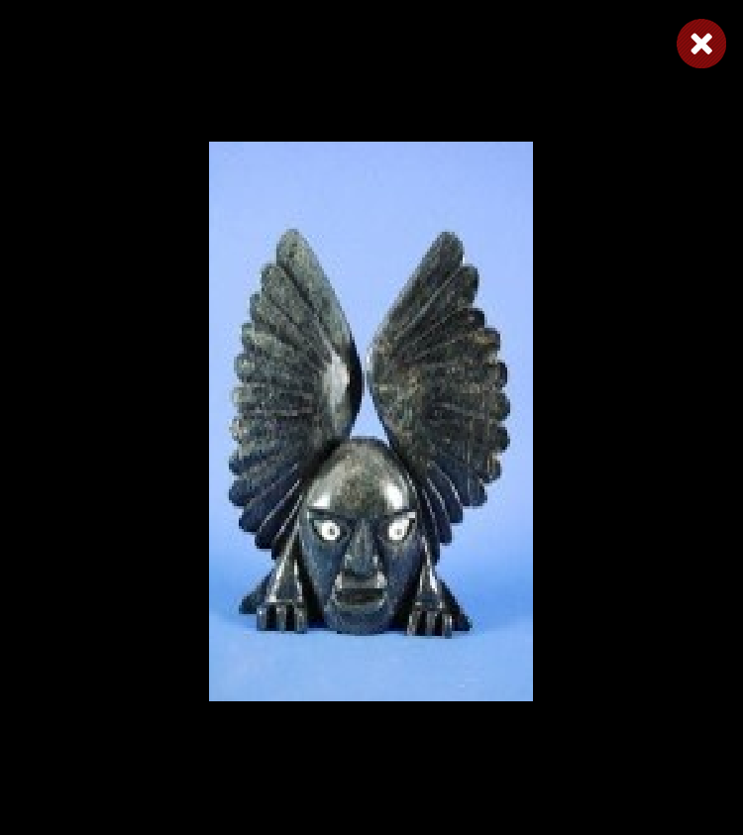
Toonoo Sharky, 1970
Cape Dorset, CA
Bird Shaman
Toonoo Sharky began carving at age nine, taught by his grandfather. His favourite subjects are “birds, and anything with wings.” But asked if he observed birds in nature, he replies: “Not often. You can look at them or work from your imagination. I don’t observe them; it is all from my head.” Toonoo’s visual statement is more emblematic than truly representative of the transformation process. For younger generations of Inuit, the imagining of shamanism and its various attributes has to a large extent supplanted actual knowledge of and belief in it.
Toonoo Sharky, b. 1970
gk }nr
1995, Stone Cape Dorset, Cape Dorset Gift of Dr. Harry Winrob, 2006-516

Slide 17
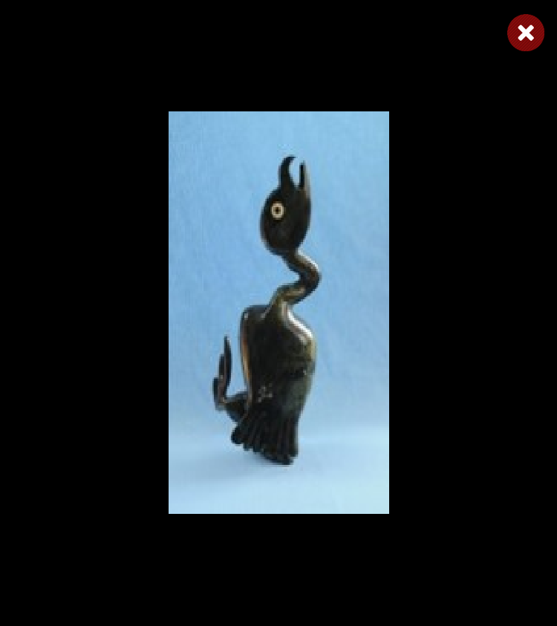
Toonoo Sharky, 1970
Cape Dorset, CA
Bird Shaman
Toonoo Sharky began carving at age nine, taught by his grandfather. His favourite subjects are “birds, and anything with wings.” But asked if he observed birds in nature, he replies: “Not often. You can look at them or work from your imagination. I don’t observe them; it is all from my head.” Toonoo’s visual statement is more emblematic than truly representative of the transformation process. For younger generations of Inuit, the imagining of shamanism and its various attributes has to a large extent supplanted actual knowledge of and belief in it.
Toonoo Sharky, b. 1970
gk }nr
1995, Stone Cape Dorset, Cape Dorset Gift of Dr. Harry Winrob, 2006-516

Slide 18

Toonoo Sharky, 1970
Cape Dorset, CA
Bird Shaman
Toonoo Sharky began carving at age nine, taught by his grandfather. His favourite subjects are “birds, and anything with wings.” But asked if he observed birds in nature, he replies: “Not often. You can look at them or work from your imagination. I don’t observe them; it is all from my head.” Toonoo’s visual statement is more emblematic than truly representative of the transformation process. For younger generations of Inuit, the imagining of shamanism and its various attributes has to a large extent supplanted actual knowledge of and belief in it.
Toonoo Sharky, b. 1970
gk }nr
1995, Stone Cape Dorset, Cape Dorset Gift of Dr. Harry Winrob, 2006-516

Slide 19
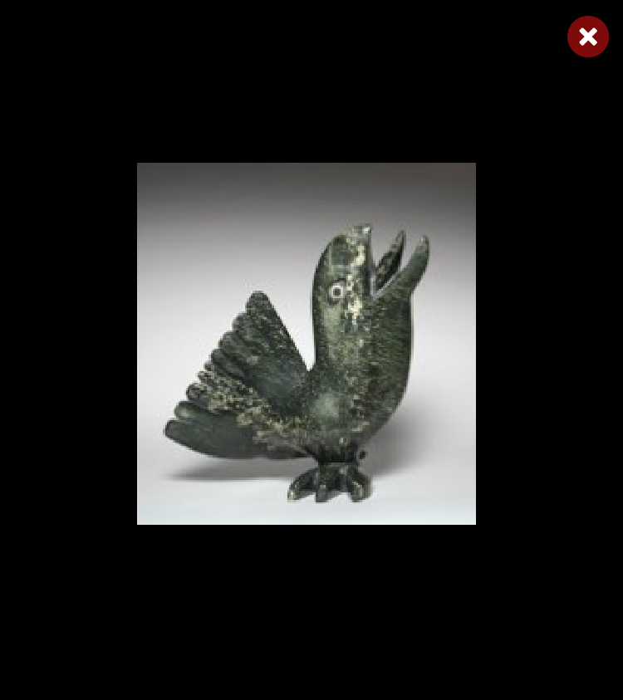
Toonoo Sharky, 1970
Cape Dorset, CA
Bird Shaman
Toonoo Sharky began carving at age nine, taught by his grandfather. His favourite subjects are “birds, and anything with wings.” But asked if he observed birds in nature, he replies: “Not often. You can look at them or work from your imagination. I don’t observe them; it is all from my head.” Toonoo’s visual statement is more emblematic than truly representative of the transformation process. For younger generations of Inuit, the imagining of shamanism and its various attributes has to a large extent supplanted actual knowledge of and belief in it.
Toonoo Sharky, b. 1970
gk }nr
1995, Stone Cape Dorset, Cape Dorset Gift of Dr. Harry Winrob, 2006-516

Slide 20
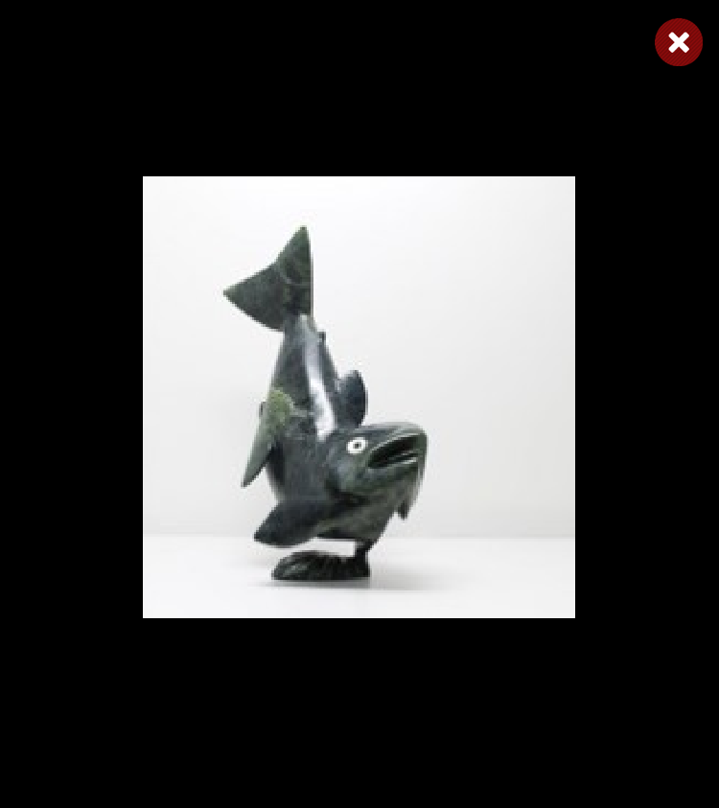
Toonoo Sharky, 1970
Cape Dorset, CA
Bird Shaman
Toonoo Sharky began carving at age nine, taught by his grandfather. His favourite subjects are “birds, and anything with wings.” But asked if he observed birds in nature, he replies: “Not often. You can look at them or work from your imagination. I don’t observe them; it is all from my head.” Toonoo’s visual statement is more emblematic than truly representative of the transformation process. For younger generations of Inuit, the imagining of shamanism and its various attributes has to a large extent supplanted actual knowledge of and belief in it.
Toonoo Sharky, b. 1970
gk }nr
1995, Stone Cape Dorset, Cape Dorset Gift of Dr. Harry Winrob, 2006-516

Slide 21
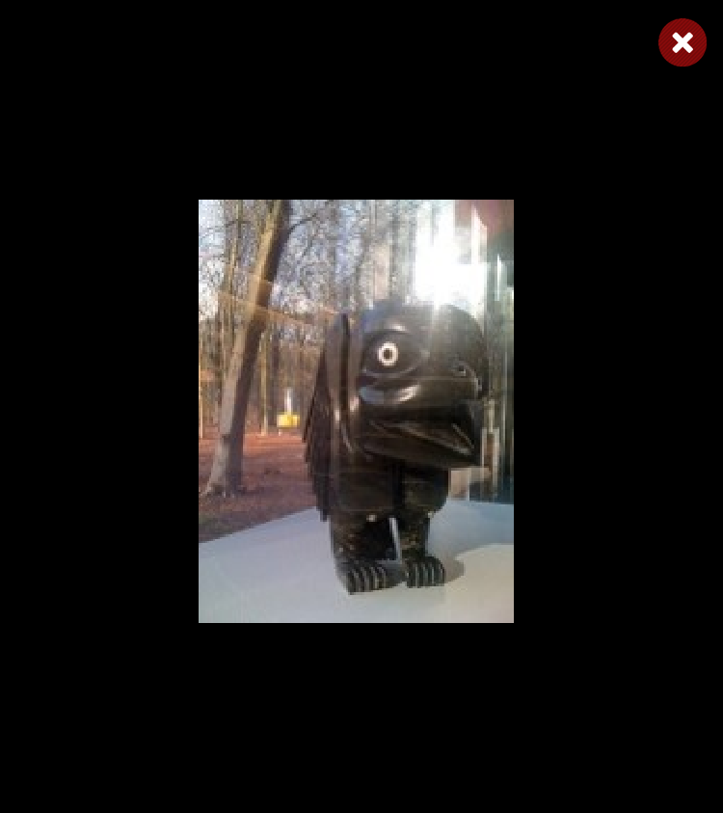
Toonoo Sharky, 1970
Cape Dorset, CA
Bird Shaman
Toonoo Sharky began carving at age nine, taught by his grandfather. His favourite subjects are “birds, and anything with wings.” But asked if he observed birds in nature, he replies: “Not often. You can look at them or work from your imagination. I don’t observe them; it is all from my head.” Toonoo’s visual statement is more emblematic than truly representative of the transformation process. For younger generations of Inuit, the imagining of shamanism and its various attributes has to a large extent supplanted actual knowledge of and belief in it.
Toonoo Sharky, b. 1970
gk }nr
1995, Stone Cape Dorset, Cape Dorset Gift of Dr. Harry Winrob, 2006-516

Slide 22
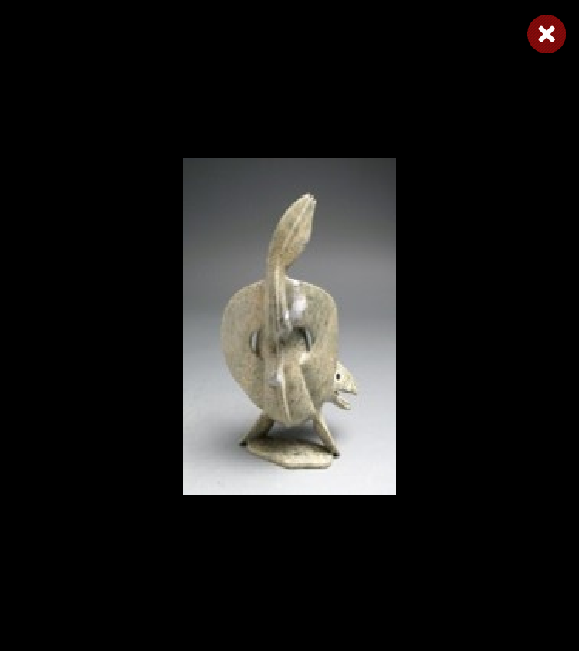
Toonoo Sharky, 1970
Cape Dorset, CA
Bird Shaman
Toonoo Sharky began carving at age nine, taught by his grandfather. His favourite subjects are “birds, and anything with wings.” But asked if he observed birds in nature, he replies: “Not often. You can look at them or work from your imagination. I don’t observe them; it is all from my head.” Toonoo’s visual statement is more emblematic than truly representative of the transformation process. For younger generations of Inuit, the imagining of shamanism and its various attributes has to a large extent supplanted actual knowledge of and belief in it.
Toonoo Sharky, b. 1970
gk }nr
1995, Stone Cape Dorset, Cape Dorset Gift of Dr. Harry Winrob, 2006-516

Slide 23
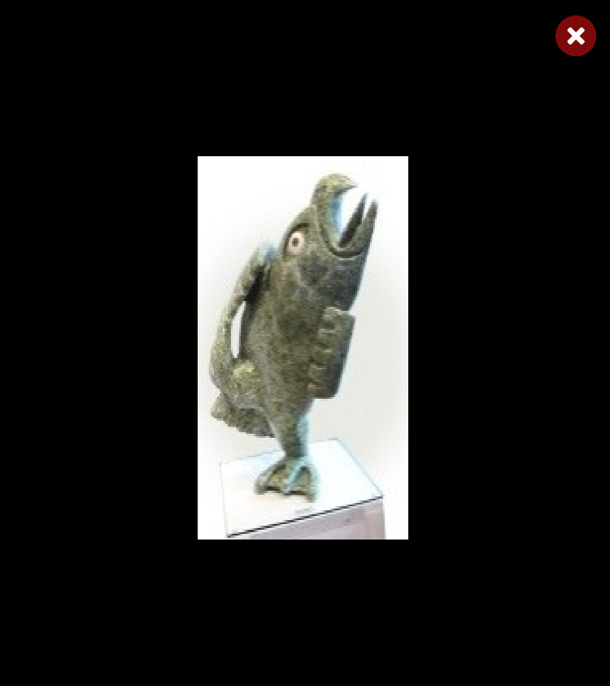
Toonoo Sharky, 1970
Cape Dorset, CA
Bird Shaman
Toonoo Sharky began carving at age nine, taught by his grandfather. His favourite subjects are “birds, and anything with wings.” But asked if he observed birds in nature, he replies: “Not often. You can look at them or work from your imagination. I don’t observe them; it is all from my head.” Toonoo’s visual statement is more emblematic than truly representative of the transformation process. For younger generations of Inuit, the imagining of shamanism and its various attributes has to a large extent supplanted actual knowledge of and belief in it.
Toonoo Sharky, b. 1970
gk }nr
1995, Stone Cape Dorset, Cape Dorset Gift of Dr. Harry Winrob, 2006-516

Slide 24
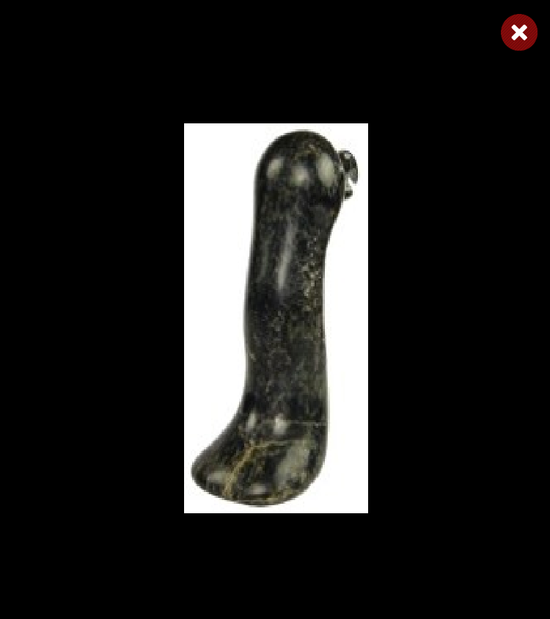
Toonoo Sharky, 1970
Cape Dorset, CA
Bird Shaman
Toonoo Sharky began carving at age nine, taught by his grandfather. His favourite subjects are “birds, and anything with wings.” But asked if he observed birds in nature, he replies: “Not often. You can look at them or work from your imagination. I don’t observe them; it is all from my head.” Toonoo’s visual statement is more emblematic than truly representative of the transformation process. For younger generations of Inuit, the imagining of shamanism and its various attributes has to a large extent supplanted actual knowledge of and belief in it.
Toonoo Sharky, b. 1970
gk }nr
1995, Stone Cape Dorset, Cape Dorset Gift of Dr. Harry Winrob, 2006-516

Slide 25
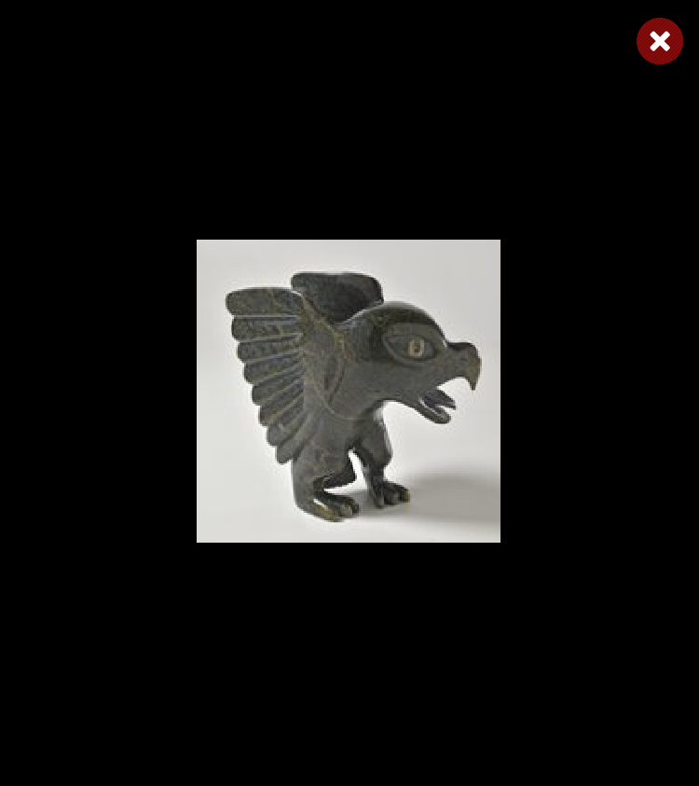
Toonoo Sharky, 1970
Cape Dorset, CA
Bird Shaman
Toonoo Sharky began carving at age nine, taught by his grandfather. His favourite subjects are “birds, and anything with wings.” But asked if he observed birds in nature, he replies: “Not often. You can look at them or work from your imagination. I don’t observe them; it is all from my head.” Toonoo’s visual statement is more emblematic than truly representative of the transformation process. For younger generations of Inuit, the imagining of shamanism and its various attributes has to a large extent supplanted actual knowledge of and belief in it.
Toonoo Sharky, b. 1970
gk }nr
1995, Stone Cape Dorset, Cape Dorset Gift of Dr. Harry Winrob, 2006-516

Slide 26
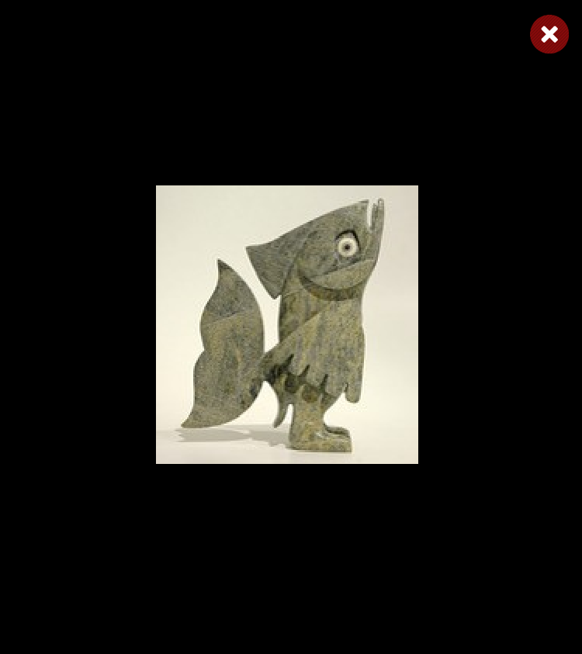
Toonoo Sharky, 1970
Cape Dorset, CA
Bird Shaman
Toonoo Sharky began carving at age nine, taught by his grandfather. His favourite subjects are “birds, and anything with wings.” But asked if he observed birds in nature, he replies: “Not often. You can look at them or work from your imagination. I don’t observe them; it is all from my head.” Toonoo’s visual statement is more emblematic than truly representative of the transformation process. For younger generations of Inuit, the imagining of shamanism and its various attributes has to a large extent supplanted actual knowledge of and belief in it.
Toonoo Sharky, b. 1970
gk }nr
1995, Stone Cape Dorset, Cape Dorset Gift of Dr. Harry Winrob, 2006-516

Slide 27
Bird Shaman
Exhibition
Toonoo Sharky, b. 1970
gk }nr
1995, Stone Cape Dorset, Cape Dorset Gift of Dr. Harry Winrob, 2006-516

Slide 28
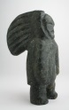
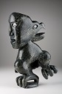

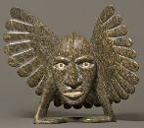
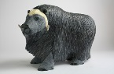
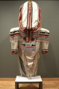

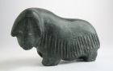
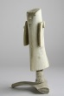
Bird Shaman
Shaman
Bird Spirits
Toonoo Sharky, b. 1970
gk }nr
Barnabus A.
Toonoo Sharky
Shaman
Steatite
Birds
Stone
Bird Shaman
Musk Ox
Toonoo Sharky
Barnabus A.
Birds
Stone
Ox
Stone
Amauti Dress
Preparing to Fly
Talerook, M.
Toonoo Sharky
Amauti
Fabric
Birds
Stone
Musk Ox
Arviat
1995, Stone Cape Dorset, Cape Dorset Gift of Dr. Harry Winrob, 2006-516
Lucassie I.
Anowtalik, L.
Ox
Antler
Antler

Slide 29
Bird Shaman
Shaman
Bird Spirits
Toonoo Sharky, b. 1970
gk }nr
Barnabus A.
Toonoo Sharky
Shaman
Steatite
Birds
Stone
Bird Shaman
Musk Ox
Toonoo Sharky
Barnabus A.
Birds
Stone
Ox
Stone
Amauti Dress
Preparing to Fly
Talerook, M.
Toonoo Sharky
Amauti
Fabric
Birds
Stone
Musk Ox
Arviat
1995, Stone Cape Dorset, Cape Dorset Gift of Dr. Harry Winrob, 2006-516
Lucassie I.
Anowtalik, L.
Ox
Antler
Antler

Slide 30
Bird Shaman
Shaman
Bird Spirits
Toonoo Sharky, b. 1970
gk }nr
Barnabus A.
Toonoo Sharky
Shaman
Steatite
Birds
Stone
Bird Shaman
Musk Ox
Toonoo Sharky
Barnabus A.
Birds
Stone
Ox
Stone
Amauti Dress
Preparing to Fly
Talerook, M.
Toonoo Sharky
Amauti
Fabric
Birds
Stone
Musk Ox
Arviat
1995, Stone Cape Dorset, Cape Dorset Gift of Dr. Harry Winrob, 2006-516
Lucassie I.
Anowtalik, L.
Ox
Antler
Antler

Slide 31
Bird Shaman
Shaman
Bird Spirits
Toonoo Sharky, b. 1970
gk }nr
Barnabus A.
Toonoo Sharky
Shaman
Steatite
Birds
Stone
Bird Shaman
Musk Ox
Toonoo Sharky
Barnabus A.
Birds
Stone
Ox
Stone
Amauti Dress
Preparing to Fly
Talerook, M.
Toonoo Sharky
Amauti
Fabric
Birds
Stone
Musk Ox
Arviat
1995, Stone Cape Dorset, Cape Dorset Gift of Dr. Harry Winrob, 2006-516
Lucassie I.
Anowtalik, L.
Ox
Antler
Antler

Slide 32
Bird Shaman
Shaman
Bird Spirits
Toonoo Sharky, b. 1970
gk }nr
Barnabus A.
Toonoo Sharky
Shaman
Steatite
Birds
Stone
Bird Shaman
Musk Ox
Toonoo Sharky
Barnabus A.
Birds
Stone
Ox
Stone
Amauti Dress
Preparing to Fly
Talerook, M.
Toonoo Sharky
Amauti
Fabric
Birds
Stone
Musk Ox
Arviat
1995, Stone Cape Dorset, Cape Dorset Gift of Dr. Harry Winrob, 2006-516
Lucassie I.
Anowtalik, L.
Ox
Antler
Antler

Slide 33
Bird Shaman
Shaman
Bird Spirits
Toonoo Sharky, b. 1970
gk }nr
Barnabus A.
Toonoo Sharky
Shaman
Steatite
Birds
Stone
Bird Shaman
Musk Ox
Toonoo Sharky
Barnabus A.
Birds
Stone
Ox
Stone
Amauti Dress
Preparing to Fly
Talerook, M.
Toonoo Sharky
Amauti
Fabric
Birds
Stone
Musk Ox
Arviat
1995, Stone Cape Dorset, Cape Dorset Gift of Dr. Harry Winrob, 2006-516
Lucassie I.
Anowtalik, L.
Ox
Antler
Antler

Slide 34
Bird Shaman
Shaman
Bird Spirits
Toonoo Sharky, b. 1970
gk }nr
Barnabus A.
Toonoo Sharky
Shaman
Steatite
Birds
Stone
Bird Shaman
Musk Ox
Toonoo Sharky
Barnabus A.
Birds
Stone
Ox
Stone
Amauti Dress
Preparing to Fly
Talerook, M.
Toonoo Sharky
Amauti
Fabric
Birds
Stone
Musk Ox
Arviat
1995, Stone Cape Dorset, Cape Dorset Gift of Dr. Harry Winrob, 2006-516
Lucassie I.
Anowtalik, L.
Ox
Antler
Antler

Slide 35
Bird Shaman
Shaman
Bird Spirits
Toonoo Sharky, b. 1970
gk }nr
Barnabus A.
Toonoo Sharky
Shaman
Steatite
Birds
Stone
Bird Shaman
Musk Ox
Toonoo Sharky
Barnabus A.
Birds
Stone
Ox
Stone
Amauti Dress
Preparing to Fly
Talerook, M.
Toonoo Sharky
Amauti
Fabric
Birds
Stone
Musk Ox
Arviat
1995, Stone Cape Dorset, Cape Dorset Gift of Dr. Harry Winrob, 2006-516
Lucassie I.
Anowtalik, L.
Ox
Antler
Antler

Slide 36
Bird Shaman
Shaman
Bird Spirits
Toonoo Sharky, b. 1970
gk }nr
Barnabus A.
Toonoo Sharky
Shaman
Steatite
Birds
Stone
Bird Shaman
Musk Ox
Toonoo Sharky
Barnabus A.
Birds
Stone
Ox
Stone
Amauti Dress
Preparing to Fly
Talerook, M.
Toonoo Sharky
Amauti
Fabric
Birds
Stone
Musk Ox
Arviat
1995, Stone Cape Dorset, Cape Dorset Gift of Dr. Harry Winrob, 2006-516
Lucassie I.
Anowtalik, L.
Ox
Antler
Antler

Slide 37
Bird Shaman
Shaman
Bird Spirits
Toonoo Sharky, b. 1970
gk }nr
Barnabus A.
Toonoo Sharky
Shaman
Steatite
Birds
Stone
Bird Shaman
Musk Ox
Toonoo Sharky
Barnabus A.
Birds
Stone
Ox
Stone
Amauti Dress
Preparing to Fly
Talerook, M.
Toonoo Sharky
Amauti
Fabric
Birds
Stone
Musk Ox
Arviat
1995, Stone Cape Dorset, Cape Dorset Gift of Dr. Harry Winrob, 2006-516
Lucassie I.
Anowtalik, L.
Ox
Antler
Antler

Slide 38
Bird Shaman
Shaman
Bird Spirits
Toonoo Sharky, b. 1970
gk }nr
Barnabus A.
Toonoo Sharky
Shaman
Steatite
Birds
Stone
Bird Shaman
Musk Ox
Toonoo Sharky
Barnabus A.
Birds
Stone
Ox
Stone
Amauti Dress
Preparing to Fly
Talerook, M.
Toonoo Sharky
Amauti
Fabric
Birds
Stone
Musk Ox
Arviat
1995, Stone Cape Dorset, Cape Dorset Gift of Dr. Harry Winrob, 2006-516
Lucassie I.
Anowtalik, L.
Ox
Antler
Antler

Slide 39
Bird Shaman
Shaman
Bird Spirits
Toonoo Sharky, b. 1970
gk }nr
Barnabus A.
Toonoo Sharky
Shaman
Steatite
Birds
Stone
Bird Shaman
Musk Ox
Toonoo Sharky
Barnabus A.
Birds
Stone
Ox
Stone
Amauti Dress
Preparing to Fly
Talerook, M.
Toonoo Sharky
Amauti
Fabric
Birds
Stone
Musk Ox
Arviat
1995, Stone Cape Dorset, Cape Dorset Gift of Dr. Harry Winrob, 2006-516
Lucassie I.
Anowtalik, L.
Ox
Antler
Antler

Slide 40
Bird Shaman
Shaman
Bird Spirits
Toonoo Sharky, b. 1970
gk }nr
Barnabus A.
Toonoo Sharky
Shaman
Steatite
Birds
Stone
Bird Shaman
Musk Ox
Toonoo Sharky
Barnabus A.
Birds
Stone
Ox
Stone
Amauti Dress
Preparing to Fly
Talerook, M.
Toonoo Sharky
Amauti
Fabric
Birds
Stone
Musk Ox
Arviat
1995, Stone Cape Dorset, Cape Dorset Gift of Dr. Harry Winrob, 2006-516
Lucassie I.
Anowtalik, L.
Ox
Antler
Antler

Slide 41
Bird Shaman
Shaman
Bird Spirits
Toonoo Sharky, b. 1970
gk }nr
Barnabus A.
Toonoo Sharky
Shaman
Steatite
Birds
Stone
Bird Shaman
Musk Ox
Toonoo Sharky
Barnabus A.
Birds
Stone
Ox
Stone
Amauti Dress
Preparing to Fly
Talerook, M.
Toonoo Sharky
Amauti
Fabric
Birds
Stone
Musk Ox
Arviat
1995, Stone Cape Dorset, Cape Dorset Gift of Dr. Harry Winrob, 2006-516
Lucassie I.
Anowtalik, L.
Ox
Antler
Antler

Slide 42
Bird Shaman
Shaman
Bird Spirits
Toonoo Sharky, b. 1970
gk }nr
Barnabus A.
Toonoo Sharky
Shaman
Steatite
Birds
Stone
Bird Shaman
Musk Ox
Toonoo Sharky
Barnabus A.
Birds
Stone
Ox
Stone
Amauti Dress
Preparing to Fly
Talerook, M.
Toonoo Sharky
Amauti
Fabric
Birds
Stone
Musk Ox
Arviat
1995, Stone Cape Dorset, Cape Dorset Gift of Dr. Harry Winrob, 2006-516
Lucassie I.
Anowtalik, L.
Ox
Antler
Antler

Slide 43
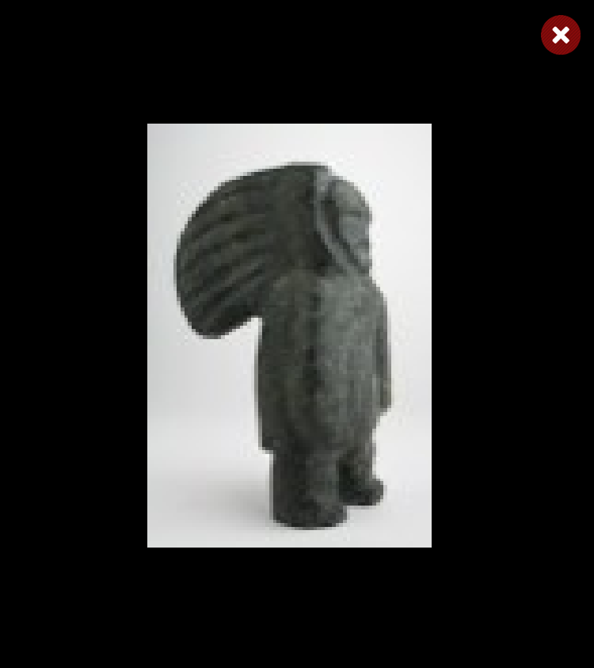
Bird Shaman
Shaman
Bird Spirits
Toonoo Sharky, b. 1970
gk }nr
Barnabus A.
Toonoo Sharky
Shaman
Steatite
Birds
Stone
Bird Shaman
Musk Ox
Toonoo Sharky
Barnabus A.
Birds
Stone
Ox
Stone
Amauti Dress
Preparing to Fly
Talerook, M.
Toonoo Sharky
Amauti
Fabric
Birds
Stone
Musk Ox
Arviat
1995, Stone Cape Dorset, Cape Dorset Gift of Dr. Harry Winrob, 2006-516
Lucassie I.
Anowtalik, L.
Ox
Antler
Antler

Slide 44
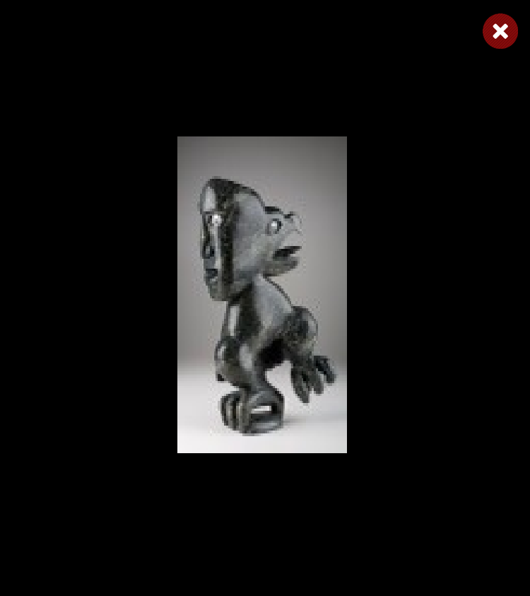
Bird Shaman
Shaman
Bird Spirits
Toonoo Sharky, b. 1970
gk }nr
Barnabus A.
Toonoo Sharky
Shaman
Steatite
Birds
Stone
Bird Shaman
Musk Ox
Toonoo Sharky
Barnabus A.
Birds
Stone
Ox
Stone
Amauti Dress
Preparing to Fly
Talerook, M.
Toonoo Sharky
Amauti
Fabric
Birds
Stone
Musk Ox
Arviat
1995, Stone Cape Dorset, Cape Dorset Gift of Dr. Harry Winrob, 2006-516
Lucassie I.
Anowtalik, L.
Ox
Antler
Antler

Slide 45
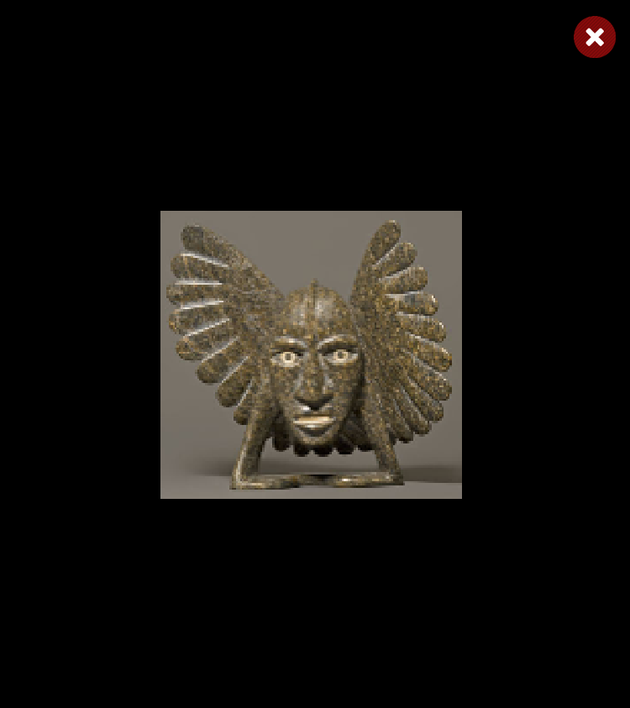
Bird Shaman
Shaman
Bird Spirits
Toonoo Sharky, b. 1970
gk }nr
Barnabus A.
Toonoo Sharky
Shaman
Steatite
Birds
Stone
Bird Shaman
Musk Ox
Toonoo Sharky
Barnabus A.
Birds
Stone
Ox
Stone
Amauti Dress
Preparing to Fly
Talerook, M.
Toonoo Sharky
Amauti
Fabric
Birds
Stone
Musk Ox
Arviat
1995, Stone Cape Dorset, Cape Dorset Gift of Dr. Harry Winrob, 2006-516
Lucassie I.
Anowtalik, L.
Ox
Antler
Antler

Slide 46
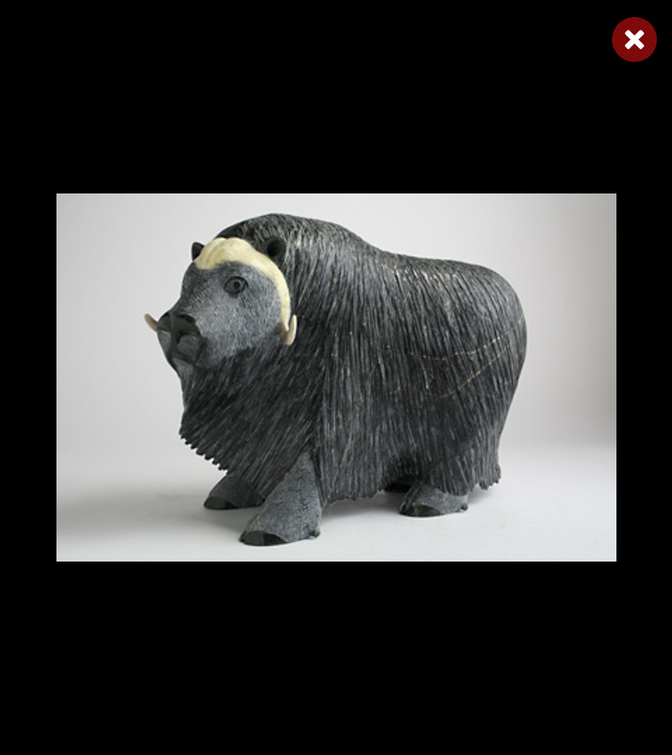
Bird Shaman
Shaman
Bird Spirits
Toonoo Sharky, b. 1970
gk }nr
Barnabus A.
Toonoo Sharky
Shaman
Steatite
Birds
Stone
Bird Shaman
Musk Ox
Toonoo Sharky
Barnabus A.
Birds
Stone
Ox
Stone
Amauti Dress
Preparing to Fly
Talerook, M.
Toonoo Sharky
Amauti
Fabric
Birds
Stone
Musk Ox
Arviat
1995, Stone Cape Dorset, Cape Dorset Gift of Dr. Harry Winrob, 2006-516
Lucassie I.
Anowtalik, L.
Ox
Antler
Antler

Slide 47
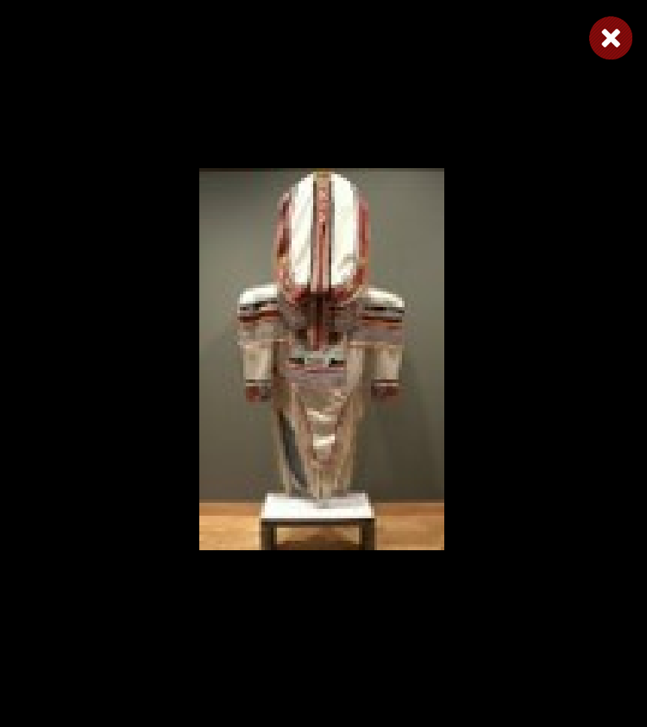
Bird Shaman
Shaman
Bird Spirits
Toonoo Sharky, b. 1970
gk }nr
Barnabus A.
Toonoo Sharky
Shaman
Steatite
Birds
Stone
Bird Shaman
Musk Ox
Toonoo Sharky
Barnabus A.
Birds
Stone
Ox
Stone
Amauti Dress
Preparing to Fly
Talerook, M.
Toonoo Sharky
Amauti
Fabric
Birds
Stone
Musk Ox
Arviat
1995, Stone Cape Dorset, Cape Dorset Gift of Dr. Harry Winrob, 2006-516
Lucassie I.
Anowtalik, L.
Ox
Antler
Antler

Slide 48
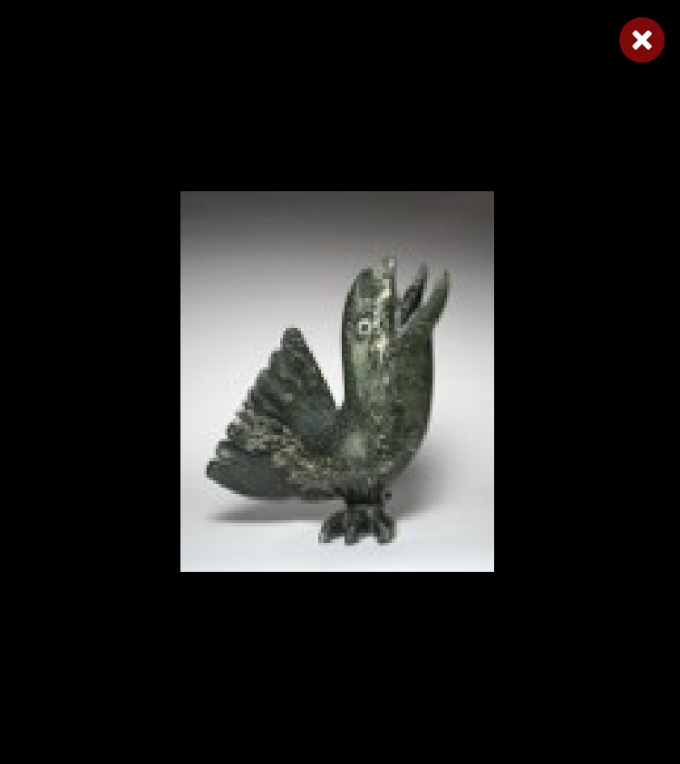
Bird Shaman
Shaman
Bird Spirits
Toonoo Sharky, b. 1970
gk }nr
Barnabus A.
Toonoo Sharky
Shaman
Steatite
Birds
Stone
Bird Shaman
Musk Ox
Toonoo Sharky
Barnabus A.
Birds
Stone
Ox
Stone
Amauti Dress
Preparing to Fly
Talerook, M.
Toonoo Sharky
Amauti
Fabric
Birds
Stone
Musk Ox
Arviat
1995, Stone Cape Dorset, Cape Dorset Gift of Dr. Harry Winrob, 2006-516
Lucassie I.
Anowtalik, L.
Ox
Antler
Antler

Slide 49

Bird Shaman
Shaman
Bird Spirits
Toonoo Sharky, b. 1970
gk }nr
Barnabus A.
Toonoo Sharky
Shaman
Steatite
Birds
Stone
Bird Shaman
Musk Ox
Toonoo Sharky
Barnabus A.
Birds
Stone
Ox
Stone
Amauti Dress
Preparing to Fly
Talerook, M.
Toonoo Sharky
Amauti
Fabric
Birds
Stone
Musk Ox
Arviat
1995, Stone Cape Dorset, Cape Dorset Gift of Dr. Harry Winrob, 2006-516
Lucassie I.
Anowtalik, L.
Ox
Antler
Antler

Slide 50

Bird Shaman
Shaman
Bird Spirits
Toonoo Sharky, b. 1970
gk }nr
Barnabus A.
Toonoo Sharky
Shaman
Steatite
Birds
Stone
Bird Shaman
Musk Ox
Toonoo Sharky
Barnabus A.
Birds
Stone
Ox
Stone
Amauti Dress
Preparing to Fly
Talerook, M.
Toonoo Sharky
Amauti
Fabric
Birds
Stone
Musk Ox
Arviat
1995, Stone Cape Dorset, Cape Dorset Gift of Dr. Harry Winrob, 2006-516
Lucassie I.
Anowtalik, L.
Ox
Antler
Antler

Slide 51

Bird Shaman
Shaman
Bird Spirits
Toonoo Sharky, b. 1970
gk }nr
Barnabus A.
Toonoo Sharky
Shaman
Steatite
Birds
Stone
Bird Shaman
Musk Ox
Toonoo Sharky
Barnabus A.
Birds
Stone
Ox
Stone
Amauti Dress
Preparing to Fly
Talerook, M.
Toonoo Sharky
Amauti
Fabric
Birds
Stone
Musk Ox
Arviat
1995, Stone Cape Dorset, Cape Dorset Gift of Dr. Harry Winrob, 2006-516
Lucassie I.
Anowtalik, L.
Ox
Antler
Antler

Slide 52
Bird Shaman
Exhibition
Toonoo Sharky, b. 1970
gk }nr
1995, Stone Cape Dorset, Cape Dorset Gift of Dr. Harry Winrob, 2006-516

Slide 53
Bird Shaman
Toonoo Sharky, b. 1970
gk }nr
1995, Stone Cape Dorset, Cape Dorset Gift of Dr. Harry Winrob, 2006-516

